Slide 1



Overview of ICT Tools Used
in Agriculture, Digital Systems of Agriculture 4.0
Kick-off Meeting
Gödöllő, 11-12. September 2017

Slide 2
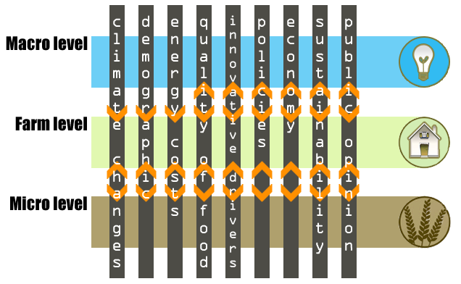
Challanges

Slide 3
Standardisation

Slide 4
Current Technological Challenges
Big Data
Internet of Things
Advanced visualization
Data models (semantic)

Slide 5
Big Data Technologies
Analysis based on more types of data
  Satellite data
  Aerial images
  IoT
    Machine telemetry
    Animal monitoring
    In-situ monitoring
  Existing (historical data) database …

Slide 6
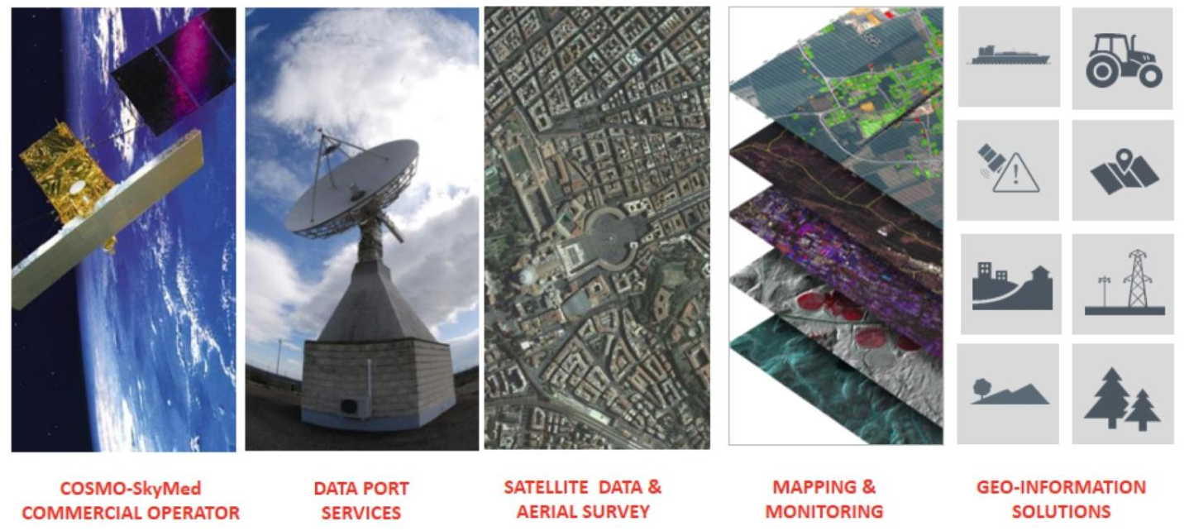
Big Data Technologies examples of large data sources usable in agriculture

Slide 7
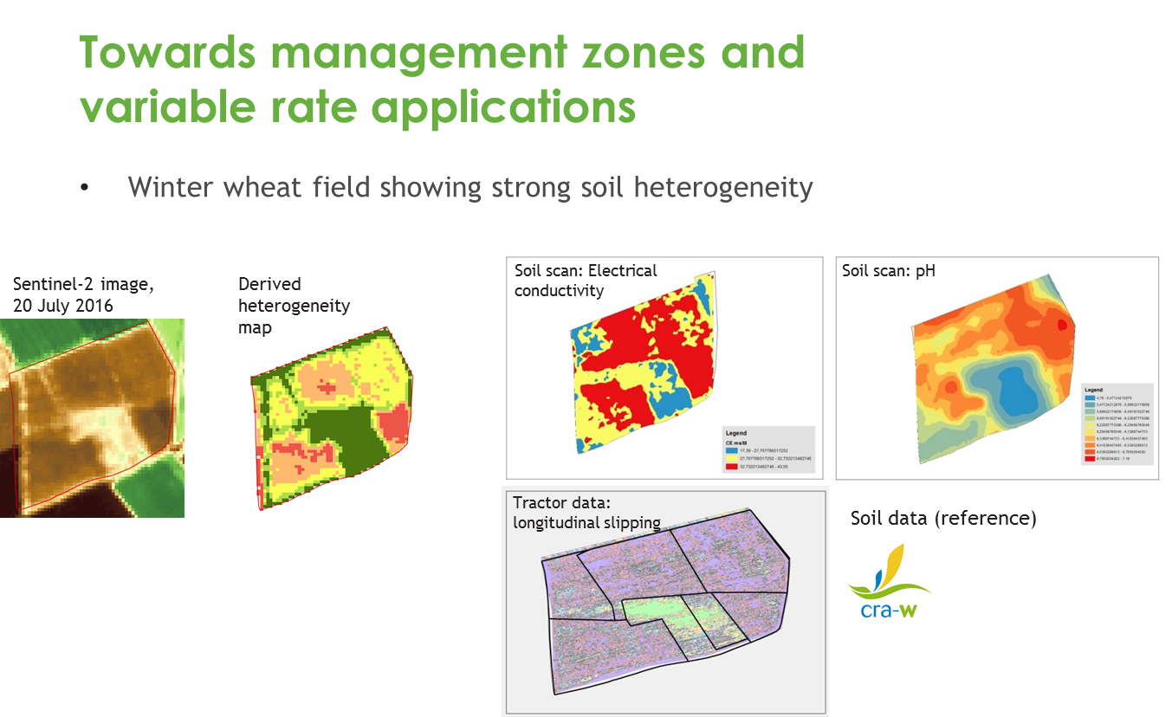
Big Data Technologies an example of calculating field heterogeneity from different types of data

Slide 8
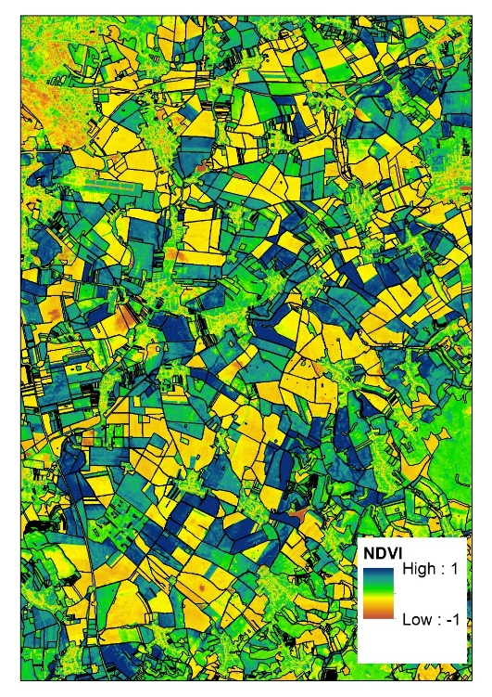
Big Data NDVI Heterogenity of Fields absolute NDVI index values
Notes:
a detail zachycení heterogenity pozemků pomocí NDVI.

Slide 9
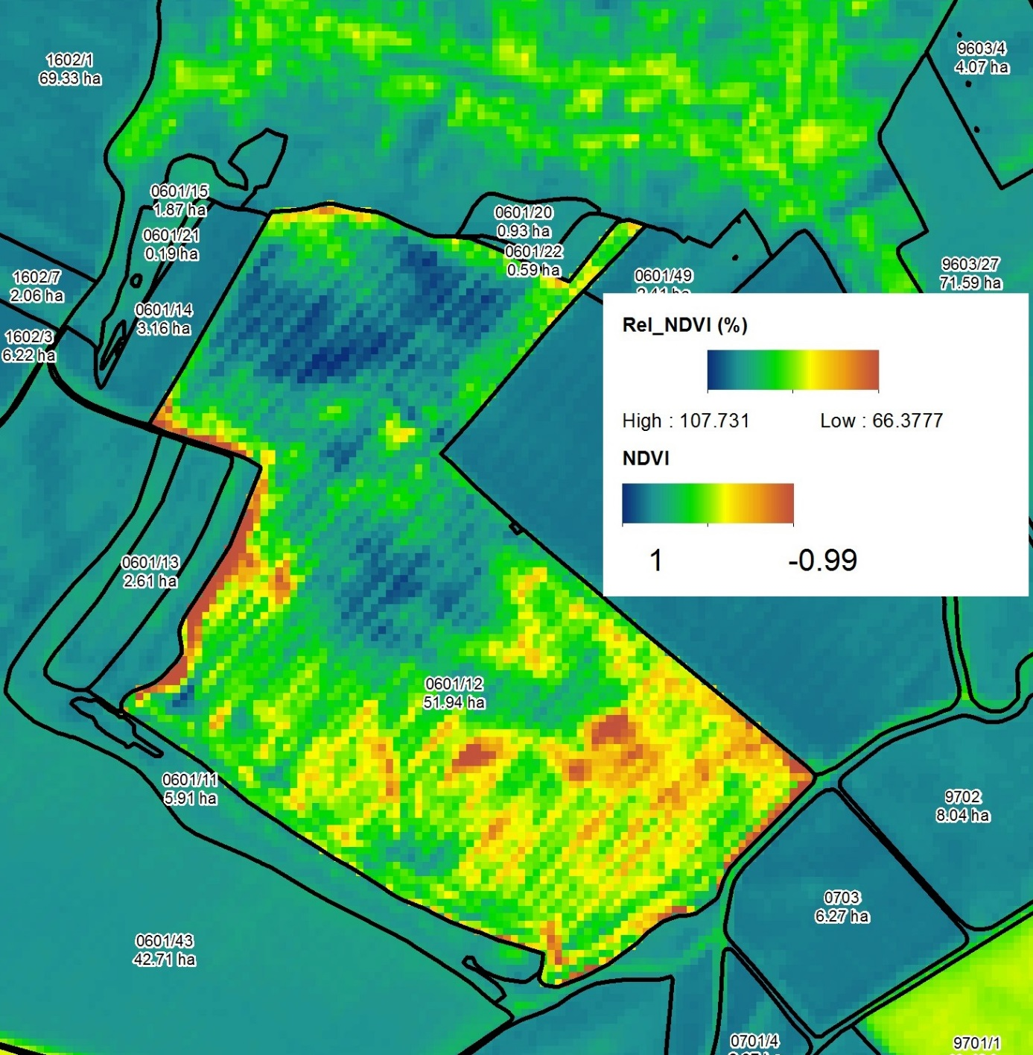
Big Data Relative NDVI on Field the relative value of NDVI index calculated for the selected field
Notes:
Relativní vyjádření NDVI pro vybraný pozemek

Slide 10
Big Data Technologies estimative mismatch between declared and actual crop

Slide 11
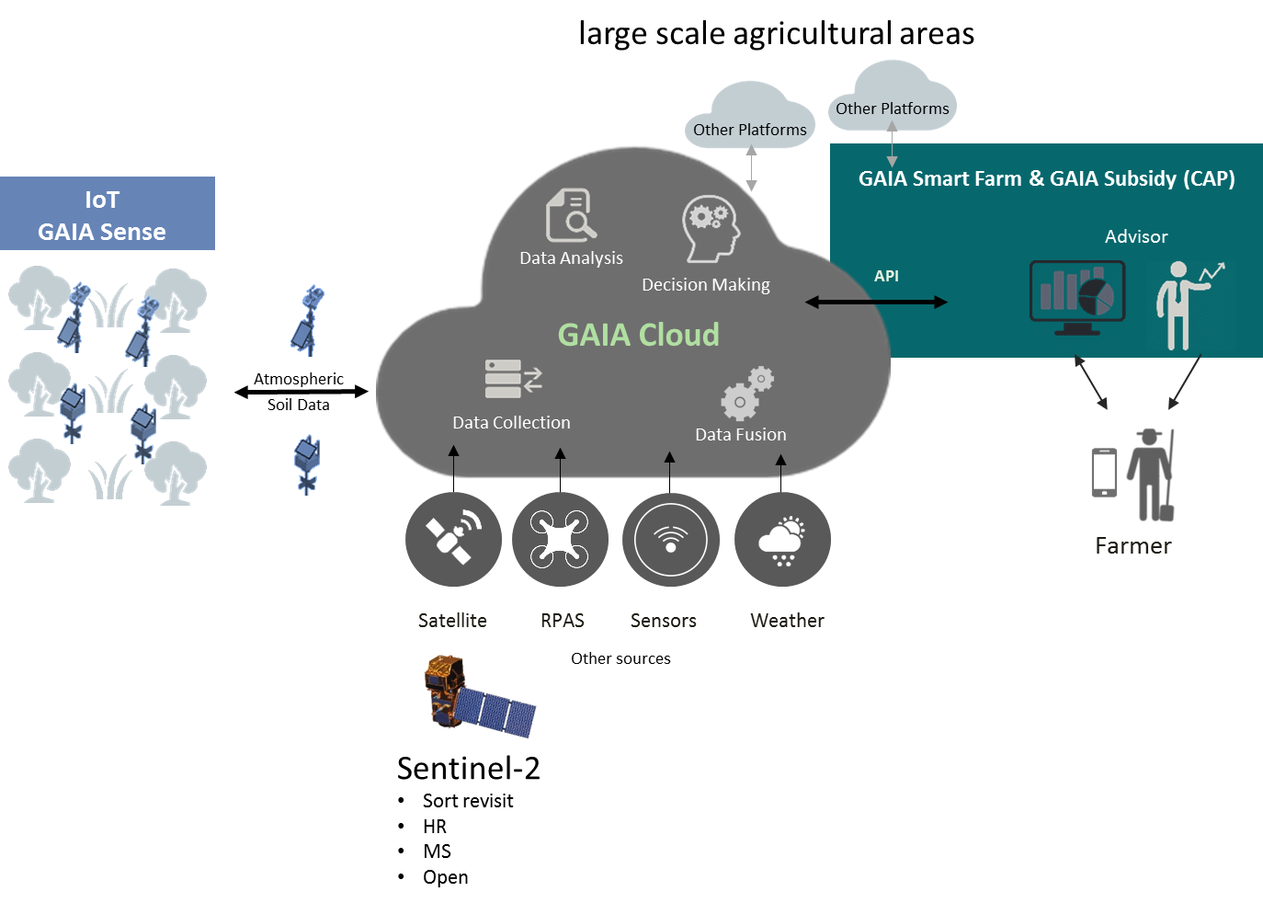
Internet of Things

Slide 12
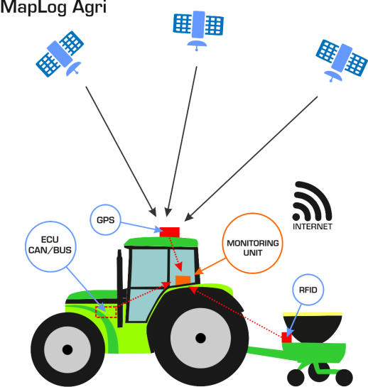
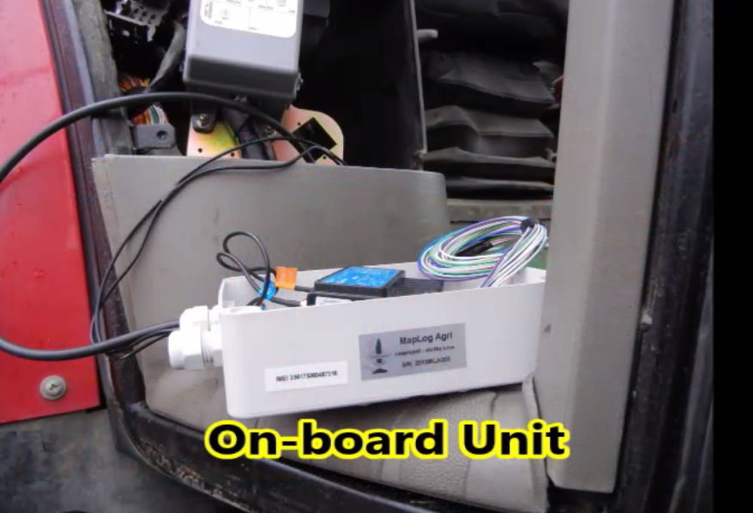
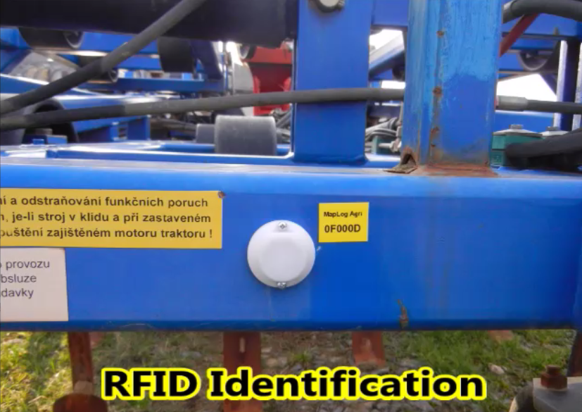
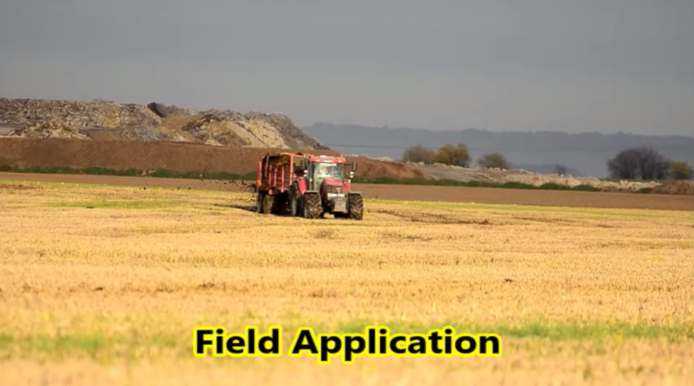
IoT Machine Telemetry collecting data of position, CAN, ISOBUS, etc…

Slide 13
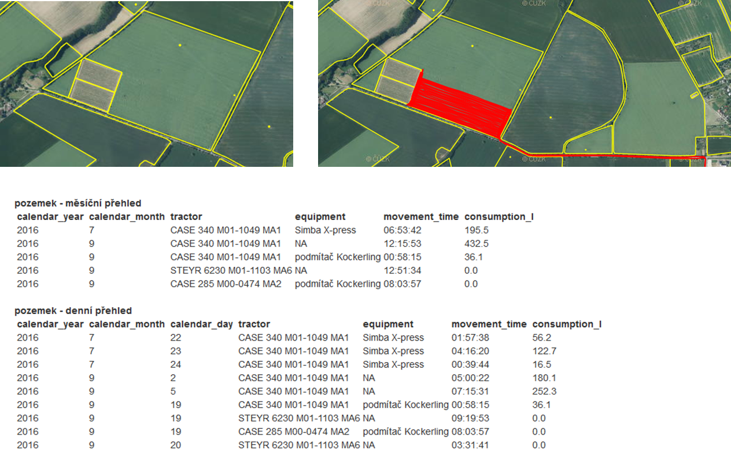
IoT Machine Telemetry
. online tillage monitoring with a tractor, equipment, time and consumption statement

Slide 14
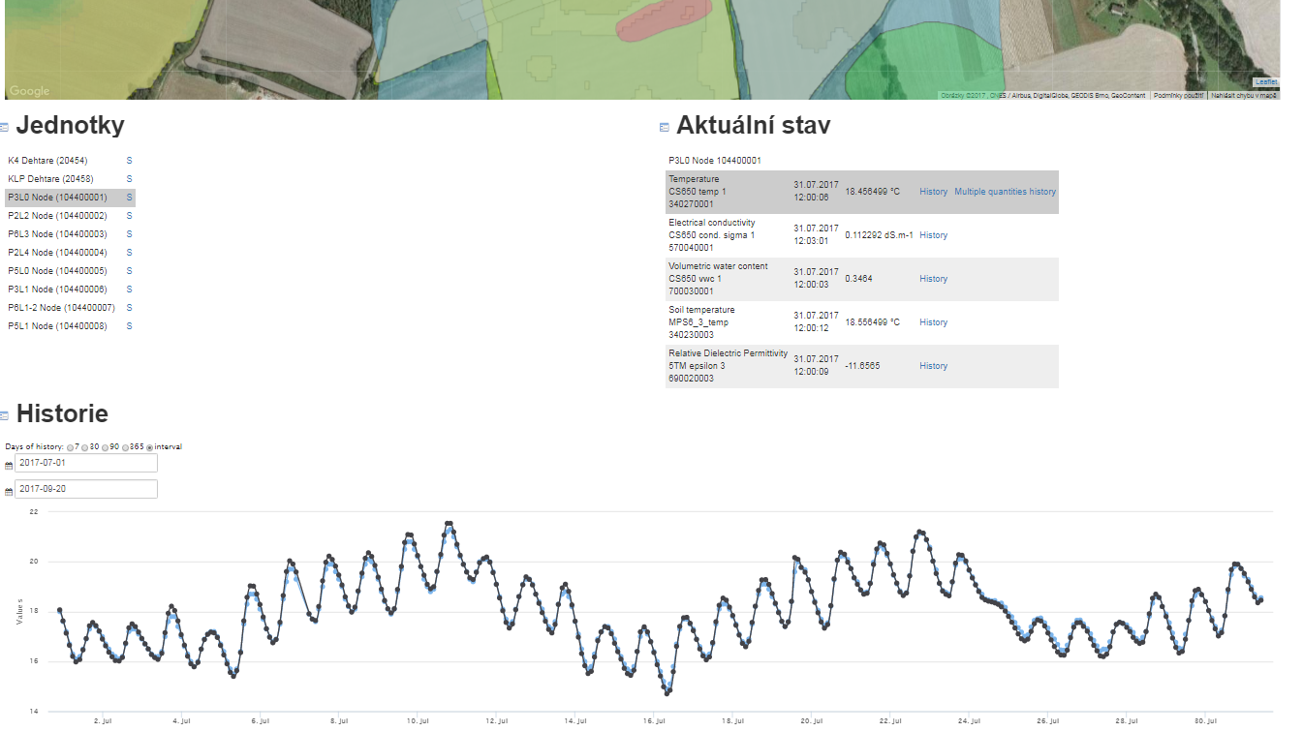
IoT in-situ Monitoring agro –meteorological data collection and analysis

Slide 15
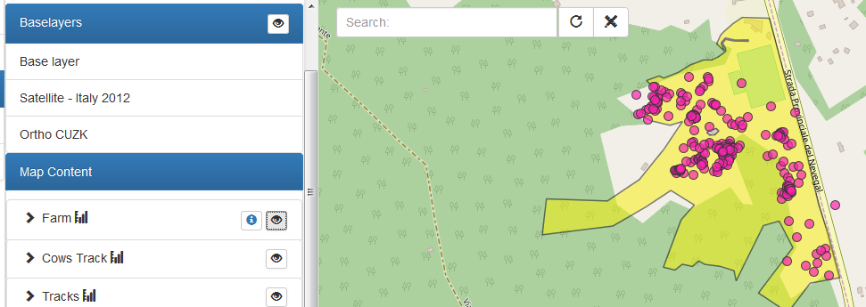
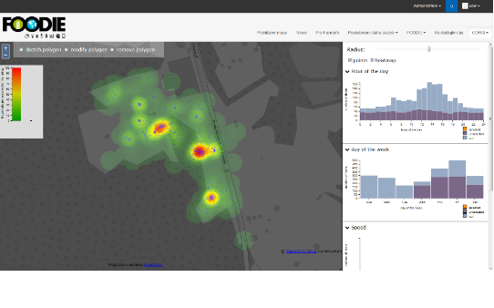
IoT Animal Monitoring animal movement monitoring and its statistical evaluation

Slide 16
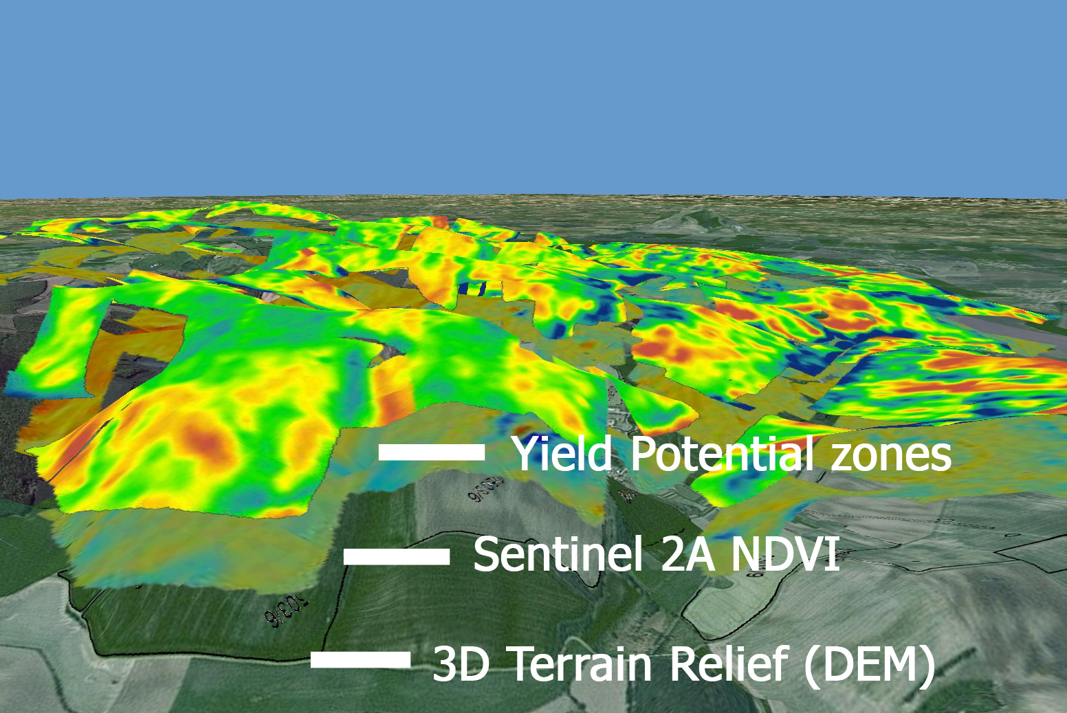
Advanced Visualization
.
3D terrain relief (DEM) + Sentinel 2A NDVI index + Yield potential zones (historic data analysis)

Slide 17
Data Model

Slide 18

Zbyněk Křivánek – WirelessInfo krivanek@wirelessinfo.cz
Pavel Šimek – WirelessInfo simek@csita.cz
1st Project Meeting
Gödöllő, 11-12. September 2017

