Slide 1



Quality Management
Anita Téringer– ITS Hungary
Connecting VET Teachers to Agriculture 4.0
Erasmus+ 2017-1-HU01-KA202-035964

Slide 2
The aims of Quality Management
evaluate the quality of results and the effectiveness of the
products in a continuous process during the whole life of the project
facilitate criticism and communication among partners (internal evaluation) 4 partner meetings
ensure that products meet the aims of the project, as expressed in the application form
Responsible partner – P2 - ITStudy
but each partner is actively involved!

Slide 3
Activities of the partnership in the field of QM:
1. Identification of processes needed for QMS and their application
2. Planning the sequence and interaction of these processes
3. Defining the criteria and methods to ensure both the operation and control of these processes are effective
4. Ensuring the availability of resources and information to support and monitoring of these processes
5. Monitoring, measuring and analyzing processes
6. Implementing actions necessary to achieve planned results and continual improvement of these processes.

Slide 4
Evaluation methods
To ensure successful development strategy we will use PDCA (Plan, Do, Check, Act) methods. Following QMS, every product and event of the project will be controlled, verified and validated. The evaluation process will be supported by:
(i) Project Quality Management Handbook (elaborated by the P2 and the coordinator) will include the rules of the communication, the documentation and reporting, monitoring and evaluation. (deadline: 31-10-2017)
(ii) Online evaluation tools implemented on the collaboration platform (the first one is now available!)
(iii) Using special evaluation templates (31-10-2017)
Notes:
The online questionnaires make the evaluation easier for the partners, and ensure a very quick and effective analysis of the results. The valuation templates provide the evaluator relevant viewpoints decreasing the time needed to complete with a correct assessment.
Using these tools provided by the P2 partner the consortium has effective support for controlling continuously the project processes and the results and as a
consequence the numbers of the evaluation need not be limited, the evaluation can be driven by the effort to reach the best quality of the products.

Slide 5
QM activities
Ongoing monitoring activities - by all partners
Ongoing financial controlling (financial reports)
Monitoring activities regarding the completion of single outputs: final check and approval of results by the coordinator and the respective output leaders
Each partner should complete quality/evaluation tools design by Quality leader.

Slide 6
Evaluation reports
Evaluation of the 4 transnational meetings
Evaluation of the 2 pilot trainings, multiplier events
Evaluation report of the 6 intellectual outputs
Evaluation of the 2 pilot trainings
Evaluation report on processes & products for interim / final reports

Slide 7
Benefits of online questionnaires
Simple editing and compilation
Personalised form
Fast filling out
Recordable
Easy processing
Combination of questions
It can easily be summed up as a report
Notes:
Rapid and easy to be used
Can be easy adapted/ personalised
It does not requires much time to be completed
The information can be recorded, as it is written information
The information may be easily to process, as questions usually are not complex
Allow for combination of questions:
yes/no
Open questions (free text input)
Ranking scale
Multiple choice
Mixture of above

Slide 8
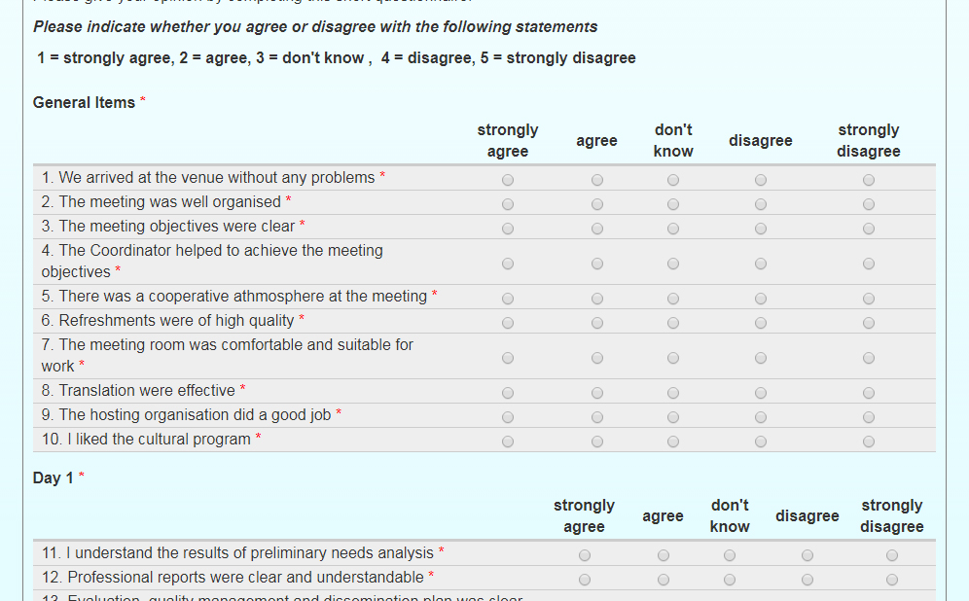
Online Evaluation

Slide 9
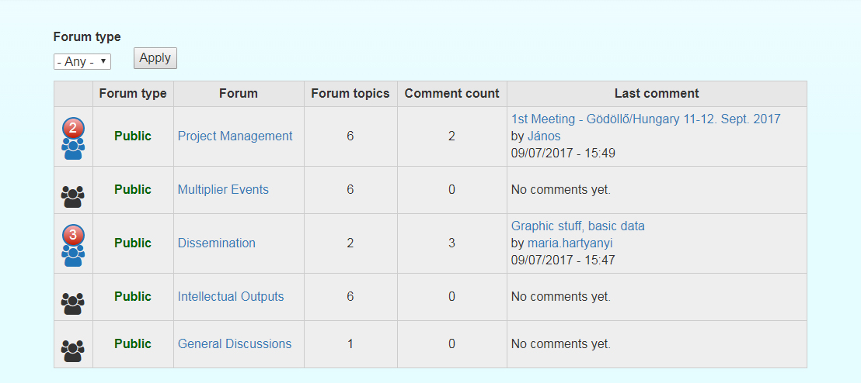
Online Communication – Portal Forum

Slide 10
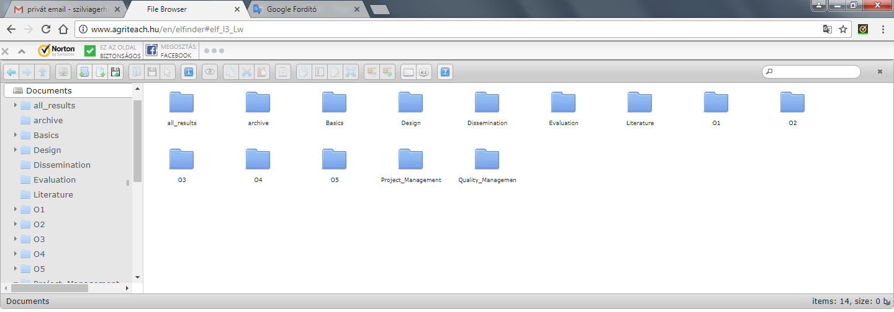
Project document storage
Notes:
All project documents will be collected and available on the project portal.

Slide 11
Thank you for your attention!

