Slide 1
Dissemination Strategy
Kick-off Meeting
Gödöllő, 11-12. September 2017

Slide 2
What is dissemination?
To disseminate something means to broadcast a message to the public without direct feedback from the audience. It comes from the latin word of disseminare „scattering seeds”.
Notes:
The expression „Dissemination” is used in the field of communication. It comes from the latin word of disseminare "scattering seeds„. Send specific informations out, our result will be spread out.

Slide 3
WHAT to disseminate
The whole of the project:
Information on the whole project… news, etc.
Concept, objectives, partnership, network, achievements, process, video contents
ABSTRACT + flyer
The project description is included in the first project newsletter To include the project description text at the end of other newsletters.
Create national versions of a project description in English, Hungarian, Macedonian, Czech

Slide 4
„products” for Dissemination
Project flyer –(including the abstract) begining of the project
Video contents – (when it will be made)
Newsletters – 6 (after every output)
News on the events – please make pictures!, publish them on the project website and your company’s own website

Slide 5
Dissemination of events (meetings and multipliers)
4 partner meetings
6 multiplier events
Including on Facebook, Twitter, Instagram, Slideshare, etc.

Slide 6
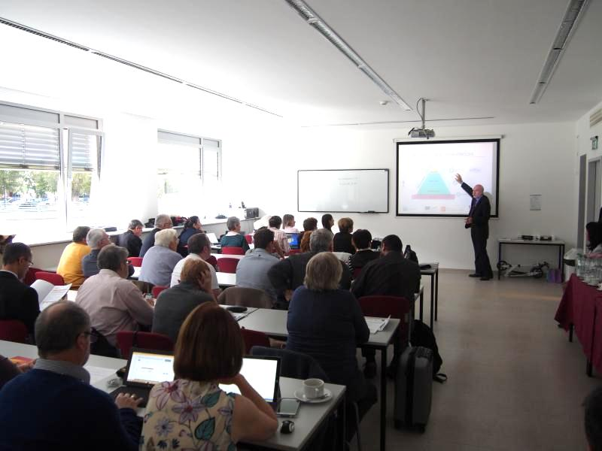
To WHOM – Target group
The target audience of the disseminations is:
Primary target group (in Macedonia & Hungary):
Agricultural VET teachers
headmasters/teachers/trainers/managers working in the agricultural VET sectors
Agricultural VET Schools and VET providers
researchers (on scientific conferences)
stakeholders - like VET related associations
policy makers
Secondary target group:
VET students
University students

Slide 7
HOW
Dissemination actions
• Face to face (presentation, roundtables, meetings, etc)
• Media based (Internet, paper based, Tv/video, etc)
• Performance based (surveys, seminars, settle workshops/pilots, etc)
Levels
Inside partner organisations
Core target groups and wider stakeholders
General public
Geographical levels:local, regional, national, European

Slide 8
WHERE: Main platforms of the dissemination activities (application)
Website
National and European level conferences
Online publications through the internet by your website and by using Web 2.0 tools (shared docs)
Flyers in four languages in document form & paper form: please make printouts for yourself
Digital newsletters (pdf)
Etc.

Slide 9
DETAILS: PARTNER INFO for Project flyer
Description | Who? | Deadline | Where to put?
Project flyers – partner info: your logo in vector format (done) small introduction of your organisation in ~5 sentences. | All partners | Logos okay, intro: 2017 september 20 | Please put it on the website under dissemination/partner folder

Slide 10
Details: Abstract translation
Description | Who? | Deadline | Where to put?
Proofreading of the abstract - English | CAPDM: Opus Learning Ltd. | 2017 september 20
Translation of the abstract Macedonian | AGFutura | 2017 +7 days
Translation of the abstract Czech | WirelessInfo | 2017 +7 days
Translation of the abstract Hungarian | ITS | 2017 +7 days

Slide 11
Details: Newsletters Newsletters - 6 newsletters after each output
Newsletters | Who? | Deadline | Where to put?
1. Newsletters after each output a picture description of the output Please leave general project info at the end of the newsletter | Output responsible partners | End of the output + 7 days | under dissemination
2. Translatation to project languages | Partners from the same coutry | End of the output + 15 days | Please put it on the website under dissemination

Slide 12
Intellectual outputs disseminate them in newsletters
Responible: leader of actual Intellectual Output
O1 = WirelessInfo – Deadline: 30 October 2017 +15 days
O2 = FACE – Deadline: 30 March 2018 +15 days
O3 = AG Futura – Deadline: 31 July 2018 +15 days
O4 = iTStudy – Deadline: 31 October 2018 +15 days
O5 = GJMSzKI – Deadline: 30 April 2019 +15 days
O6 = GAK – Deadline: 31 August 2019 +15 days

Slide 13
Newsletters | Who? | Deadline | Where to put?
3. Disseminate the newsletter on your website + some web 2.0 (if possible) | All partners | End of the output + 15 days | Please make evidences, photos, printscreens, etc.
4. Provide those evidences and upload to dissemination form | All partners | End of the output + 15 days | Please upload the evidences at the end of the dissemination form, and also for your dissemination folder - AS MUCH AS POSSIBLE (printscreens, photos, documents, scan copies, etc. )

Slide 14
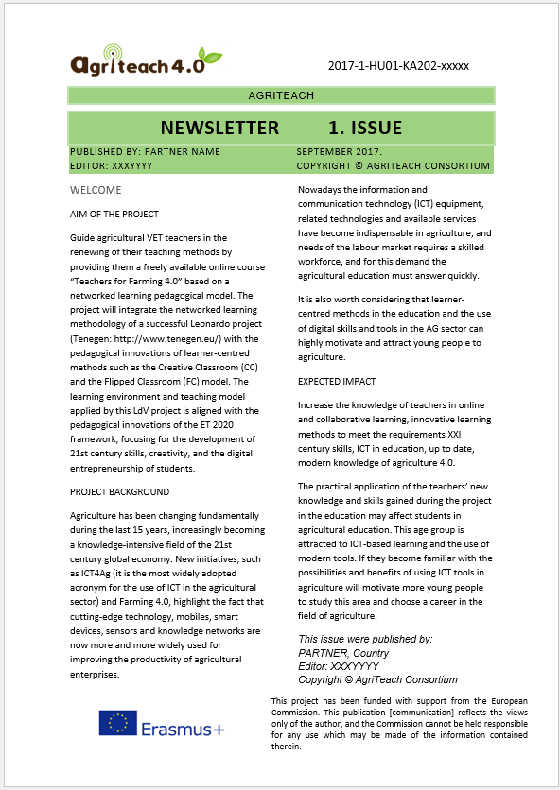
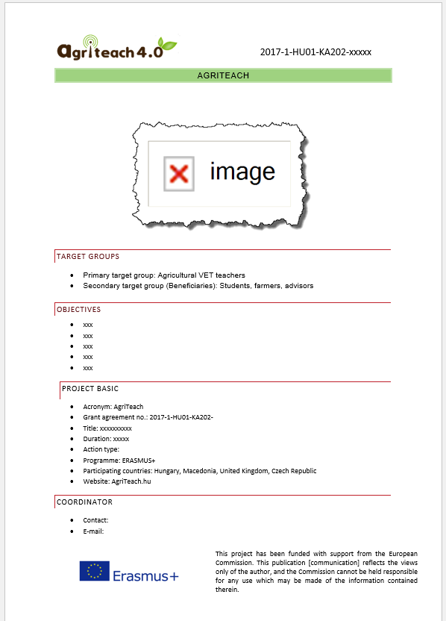

Slide 16
Project websites
The websites is mentioned in the application:
For project communication purposes this platform shall be used: http://www.agriteach.hu/en/forum
For outside communication and dissemination and also for later project communication http://agritech.hu shall be used, this will be developed during the project. Responsible partner: GJMSzKI

Slide 17
News - website news
News | Who? | Deadline | Where to put?
Every meeting or multiplier event shall be put to WEBSITE NEWS (- 1 picture, Small description in 2 sentences for web 2.0 publication, Longer description.) | All partners | Meeting/event date + 7 days | Please put at website NEWS section in English and national language create a translation of it in your language.
Fill a dissemination form for the dissemination Place the proofs to the dissemination folder. | All partners | Meeting/event date + 7 days | Dissemination form on the platform

Slide 18
Strong web 2.0 publication
Web 2.0 platform – only examples
LinkedIn (FACE) | Each partner shall make web 2.0 publications as much as possible, minimum is 6 piece by partner in 3 years. (Please fill a dissemination form to this as well ☺ ) FACEBOOK editor login can be given by GJMSZI. Please choose a responsible facebook editor/partner, and ask for FB permisson.) If you create an AgriTeach project profile/page on any platform, please inform the partnership on the forum (eg. Youtube or any national portal). Please use tags and keywords referring to agriteach, like #agriteach
Facebook - Galamb(+Twitter?)
Instagram
Slideshare http://www.slideshare.net/
Online presentations : mindmeister Prezi, ppt or other
Blog – on your website
Youtube, Vimeo or other video channels

Slide 19
Proof of your dissemination activities
• photos
• print screen/ scan copies of articles, publications (printed/on – line newspapers, magazines, newsletters, etc.)
• list of workshop participants with signatures
• print screens of websites
• list of contacts (e-mails, e-groups, etc.)
• nr. of leaflets distributed – in case of printed versions
• make a printscreen of the shared video contents

Slide 20
Provide accurate reporting in order to make reporting easy – DISSEMINATION ACTION LIST
produce the dissemination content
disseminate it
make proof of dissemination
record it into dissemination form
place your proof to your dissemination folder on the AgriTeachwebsite
put evidences at the end of the form (lot of types are allowed to upload, but if there is a problem, write to the forum and we will solve the problem)
PLEASE FILL THE FORM FOR DISSEMINATION ABOUT ACITIVITES, too.

Slide 22
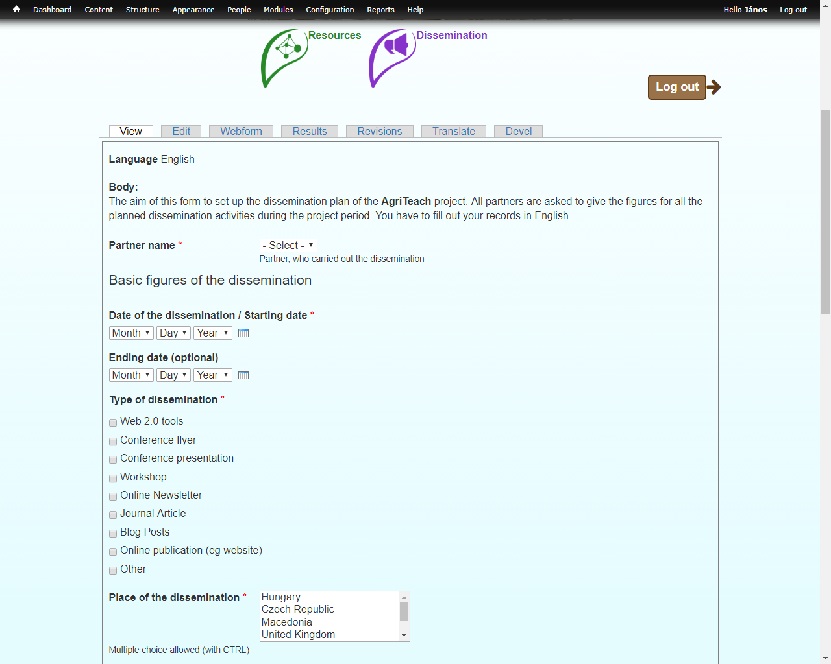

Slide 23
iTStudy Ltd. Hungary (P2)
by János Szabó – janos.szabo@itstudy.hu
1st Project Meeting – Gödöllő, 21-22 September 2017

