Slide 1



Structure of learning content for AgriTeach 4.0
Anita Téringer– ITS Hungary

Slide 2
AgriTeach Curriculum
O3 – Syllabus and learning content for AgriTeach 4.0 - P4 - AGFT ⏳ 30 July 2018
* O3-A1 Development of the AgriTeach 4.0 module syllabi - CAPDM
O3-A2 Module 1: Reinventing agricultural education – ITS Collaborators: CAPDM, GJMGSZI, GAK
O3-A3 Module 2: European Strategies and initiatives of e-Agriculture – GAK Collaborators: AGFT, FACE, WRLS
O3-A4 Module 3: Digital systems of Agriculture 4.0 – AGFT Collaborators: GAK, FACE, WRLS
COURSE DESCRIPTION
MODULE STRUCTURE
Notes:
O3-A1 - CAPDM
Development of the AgriTeach 4.0 module syllabi by 30 April
This task will be completed afterards, when the modules are ready

Slide 3
Course description 1.
Introduction
  Background, abstract of project description
  Agriculture is changing fundamentally during the last 15 years, it is increasingly becoming a knowledge-intensive field of the global economy of the 21st century. New phenomenon like smart farming, e-agriculture and Farming 4.0 indicate that cutting-edge technology, mobiles, smart devices, sensors and knowledge networks are more and more widely used for improving the productivity of the agricultural enterprises.
Aim of the course
  The course is aimed at transferring knowledge of …. and upgrading practical skills for ......
Level of award
  EQF level … and corresponding national qualifications framework
Notes:
“Teachers for Farming 4.0”

Slide 4
Course description 2.
Credit
  State the number of credits the course will deliver. E.g. in the HU system 1 credit corresponds to 1 hour of study
Certificate
  Specify the type of certificate awarded after successful completion of the course
Target group
  Agricultural VET teachers
Entry pre-requisites
  State if previous knowledge or experience needed before enrolling to the course.

Slide 5
Course description 3.
Duration
  Recommended timing only. Actual duration depends on participants’ previous knowledge.
Training methodology
  Specify methodology applied in the course.
  Networked learning methodology integrated with the Flipped Classroom (FC) model.
Course modules
  Module 1: Reinventing agricultural education
  Module 2: European Strategies and initiatives of e-Agriculture
  Module 3: Digital systems of Agriculture 4.0

Slide 6
Course description 4.
Assignments
  Tasks that participants are expected to perform.
  Assessment of performance level is based on these assigments.
1. Activity in online collaboration and in the discussion Forums related to the modules.
2. One credited Assignment for each module
3. Online Test - after completing the three modules

Slide 7
Course description 4.
Assessment methods
Depending on the instructor of the course
(a) The activities and the result of the online test will be evaluated by the tutor and/or
(b) based on the automatic evaluation of exam test by the Moodle system.
Pass Grade: 75%

Slide 8
Module structure
Course description ☑
Module 1
Module 2
Module 3

Slide 9
Parts of a module
Description, weight
Content
Learning outcomes
Learning instructions
Assignments and performance criteria
Forum discussion
Conclusion
Test questions
Materials and resources
Notes:
Let us look at them in detail
Template will be provided

Slide 10
Module description, weight
Module 1: Reinventing agricultural education
Rationale – objective of the module
This module will help participants to understand and apply…
They will develop a full understanding of ...., learn how to......
This module aims to explain how to...
Weight : …. % - the relative importance of content in the overall course

Slide 11
Content - Topics
Define the topics
  1.1 Assessment, learning and digital education
  1.2 Digital education: strategies and policies.
  1.3 Understanding learning in an online environment: options and models
  1.4 Teaching resources and the digital student experience

Slide 12
Content - Digital learning objects
For each topic
  list the content items
  specify their types and
  formats
  1.1 Assessment, learning and digital education
These multimedia objects will be integrated into the e-book.
Content item | Type | Format
…. | movie | mp4
…. | presentation | ppt
…. | text | docx

Slide 13
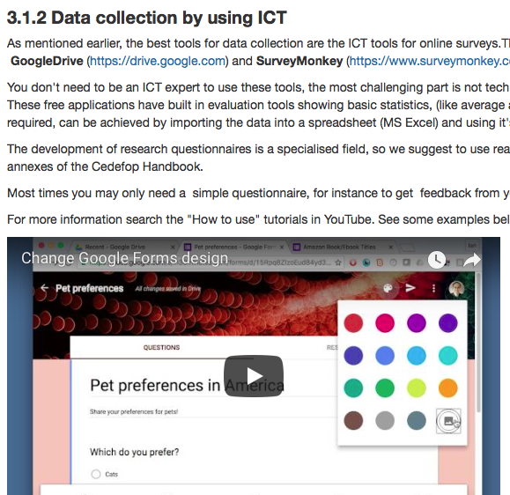
Content – the look

Slide 14
Learning outcomes
Define what the students are be expected to know at the end of the course
  use action verbs
  make it assessable
  By the end of the module the participant will be able to:
  list and explain the steps of …..
  search for ….
  operate .....
  identify and select ...

Slide 15
Learning instructions
Step-by-step guidance, advice on how to complete the module
Recommended timing
To complete Module 1, please
Read the following learning content: ….... While reading, answer the questions and solve the quizzes included. Use the glossary if you are not familiar with a special term.
Read the additional contents in Module 1: …....
Join in the discussions on the Forum for Module 1.
Submit your Assignments for credits for Module 1.

Slide 16
Assignments and performance criteria
Types of assignments: practice exercise, quiz, case study etc.
One credited assignment is mandatory.
For each assigment, please specify the
description of task
method of submission
performance criteria (achievable scores, method of assessment, pass rate)
materials and resources needed (e.g. templates, references, technical devices etc.)
Notes:
Assignment or ACTIVITY

Slide 17
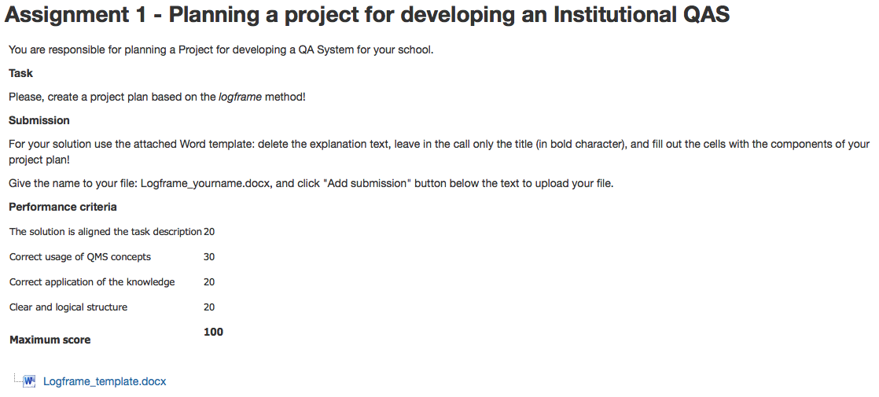
Example for a credited assignment

Slide 18
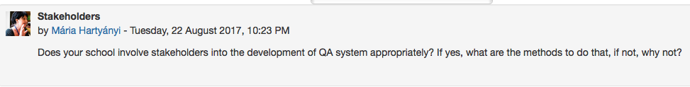
Forum discussion
Specify forum topics related to the module
Formulate questions within each topic

Slide 19
Conclusion
Highlight the key points in the module
Give a brief summary of the main messages intended to be delivered in the module.
Do not add new information here.

Slide 20
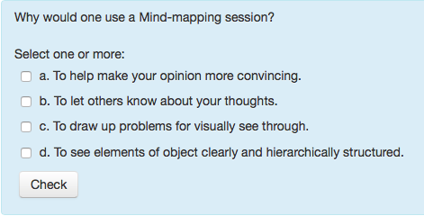
Test questions
A total of approx. 60 questions needed for the whole course.
The number of questions per module depends on the weight of the module in the course.
Recommended types of questions are multiple choice, true­­/false, matching.
Notes:
Explain weight - if module 1 is 25%, then you need to write 15 questions

Slide 21
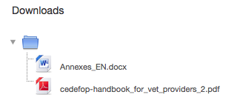

Materials and resources
Templates
Guides
References
Bibliography
Notes:
Any other resources needed to complete the course

Slide 22
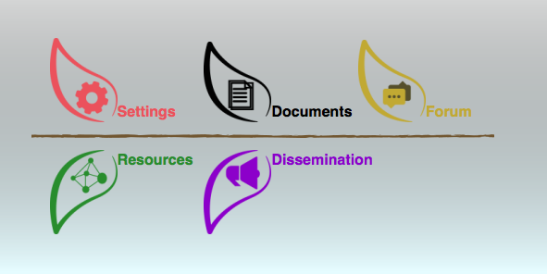
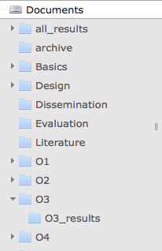
Documents
Curriculum template
Module structure example
Notes:
Show the documents on the website

Slide 23
Timing
O3 – Syllabus and learning content for AgriTeach 4.0 - P4 - AGFT ⏳ 30 July 2018
Any questions?

Slide 24
Thank you for your attention.

